Slide 1
Negative Binomial Regression
of
Farmers Markets Occurrences
A Self-Directed Study by Michiel Besseling
Master’s Capstone Project
Western Governors University
July 2020

Slide 2
Motivation
• Farmers markets have been on the rise since the beginning of the 21st century.
• Research shows farmers markets benefit farmers and consumers alike (Rodriguez et al 2019).
• Farmers benefit by increasing sales and establishing relationships with the community.
• Consumers benefit by having access to healthy foods and by socializing.

Slide 3
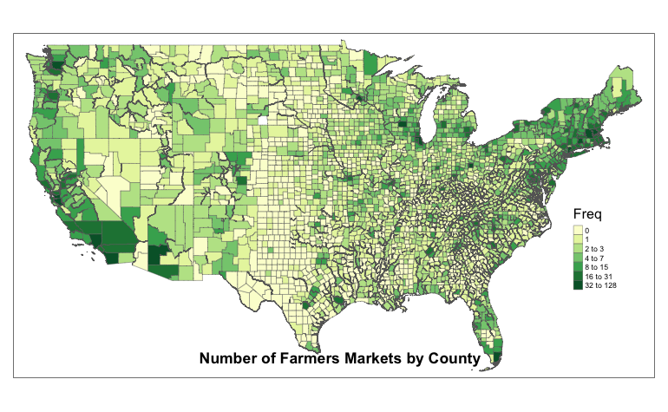

Slide 4
Motivation
Are farmers markets equally distributed across the US?
Given the current trends, are there regions that are underserved by farmers markets?
If an entrepreneur is looking to start a farmers market with no location in mind, how can s/he identify the top counties underserved by farmers markets?
If an entrepreneur is looking to start a farmers market with a location in mind, how saturated is the county?

Slide 5
Research Question
Given a multivariate profile of a given county, how many farmers markets would one expect in that county?
Given a multivariate profile of a given county, how many farmers markets would one expect in that county?

Slide 6
Overview of Presentation
• Data Gathering, Cleaning, and Preparation
• Data Exploration
• Model Building
• Findings and Insights
• Limitations
• Proposed actions
• Expected Benefits

Slide 7
Data Gathering, Cleaning, and Preparation
Initial Data Set: All 8,804 farmers markets registered with the USDA.
Goal: Determine the number of farmers markets per county and match that with a multitude of county level statistics.

Slide 8
Data Gathering, Cleaning, and Preparation
Data was gathered from the 2010 US Census, 2018 US Department of Agriculture, and 2008, 2012, and 2016 presidential election data.
The variables (far too many too list) include the following topics:
• total population • job types • median income
• age distribution • presidential elections • public health metrics
• agriculture sales • family metrics • weather data
• ethnic makeup • levels of education • geography
• crime rates • housing data

Slide 9
Data Gathering, Cleaning, and Preparation
Link to cleaned data:
https://drive.google.com/file/d/19Tox9LTJf8vVK9-FW-36SPiElDAn_2Gn/view?usp=sharing

Slide 10
Data Gathering, Cleaning, and Preparation
The final data set included 3,114 rows (counties) and 121 variables.
The population is the lower 48 states, Hawaii, and DC.
The response variable is the number of farmers markets per county.
116 farmers markets were dropped (either outside the population, or unable to match to a county)
A total of 8,688 farmers markets are represented in the final data set.

Slide 11
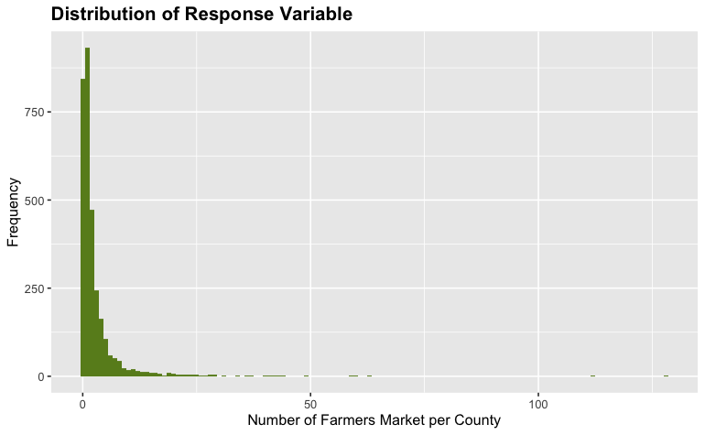
Data Exploration

Slide 12
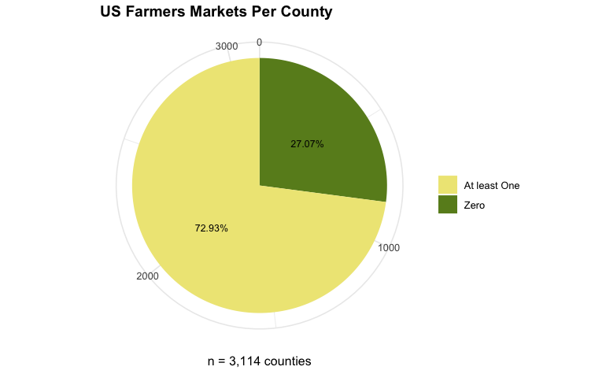

Slide 13
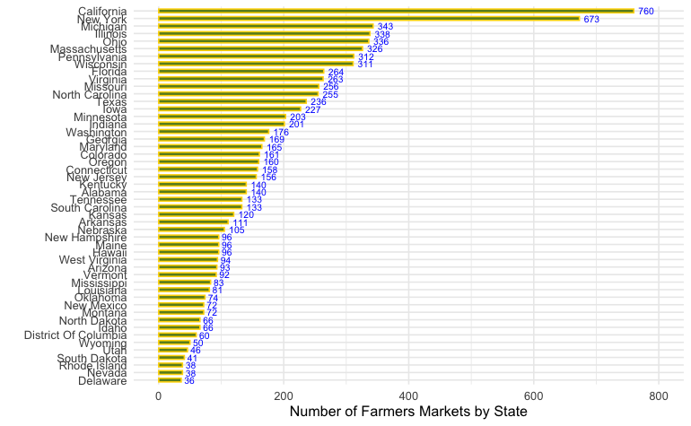

Slide 14
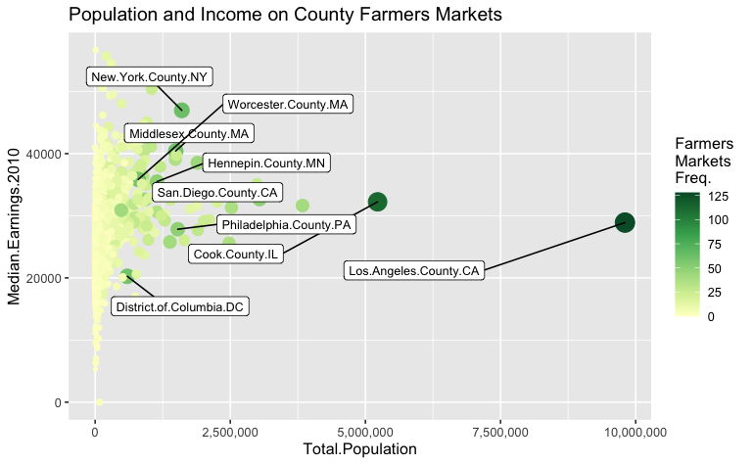

Slide 15
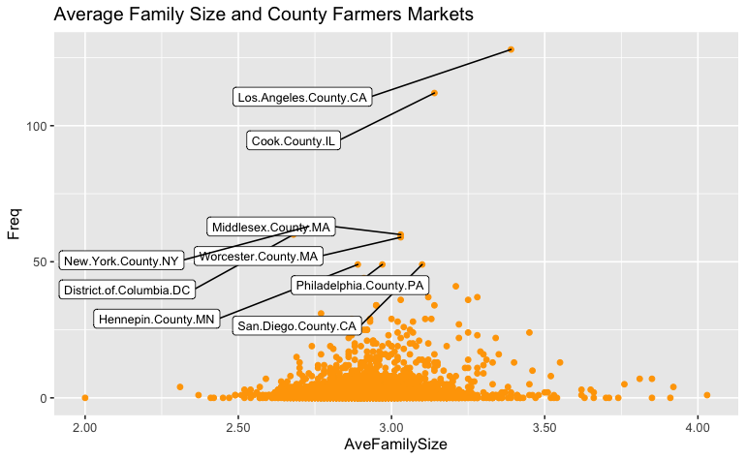

Slide 16
Data Exploration
PCA was used to discover the relationships between individuals and variables.
PCA dimensions (like on the x and y axes) explain variation in the data. The dimensions can be explained by the contribution of each variable or individual.
A PCA biplot graphs individuals and variables on the same variables. Individuals and/or variables that are near each other share similar characteristics with respect to those two dimensions.

Slide 17
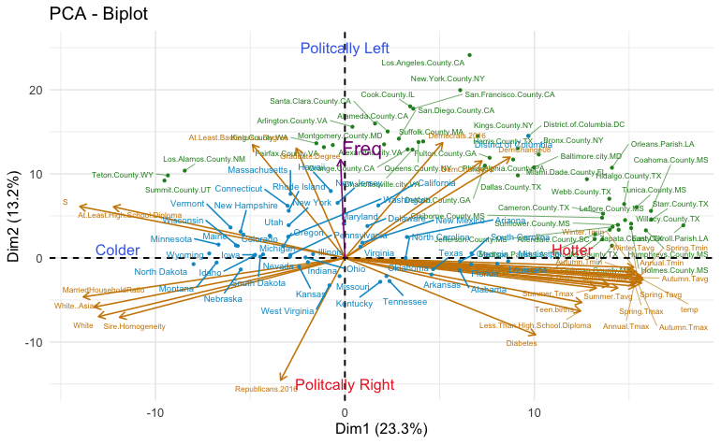

Slide 18
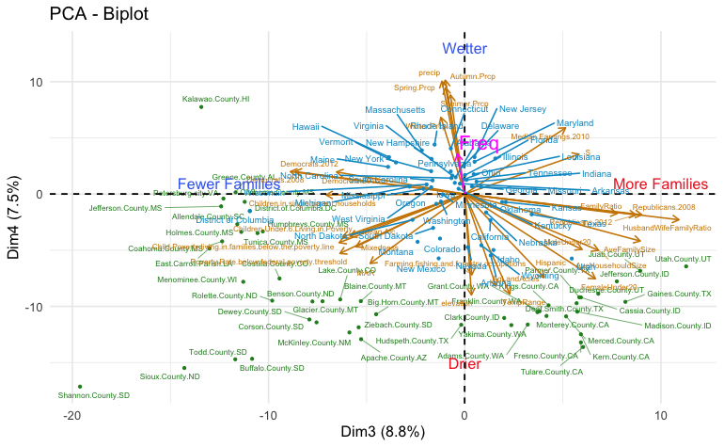

Slide 19
Data Exploration
Lastly hierarchical clustering is used to group counties into 7 clusters based on similar characteristics.
A link to the list of variables strongly correlated is here: https://docs.google.com/spreadsheets/d/10Cs650zS4pvynx-Q8FOIPX7BYQrnPZZ2RE9I4yohko4/edit?usp=sharing
Clusters are generalized on next slide.

Slide 20
Data Exploration
Cluster 1: older, retired, higher in elevation, Libertarians
Cluster 2: White, change in Republican votes, lower education levels
Cluster 3: educated, multicultural, higher education levels, Green Party, younger
Cluster 4: young, Hispanic, large agriculture, lower education levels, farming jobs
Cluster 5: warm, Republican, low public health levels,
Cluster 6: large populations, renters, Democrats, higher crime levels, multicultural
Cluster 7: African-American, low public health levels, warm, low education levels

Slide 21
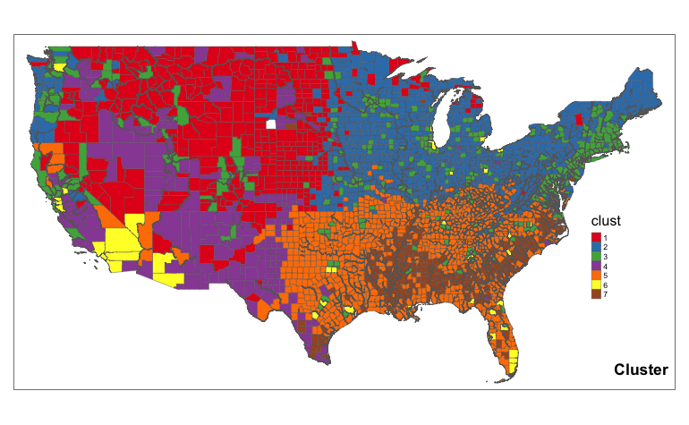

Slide 22
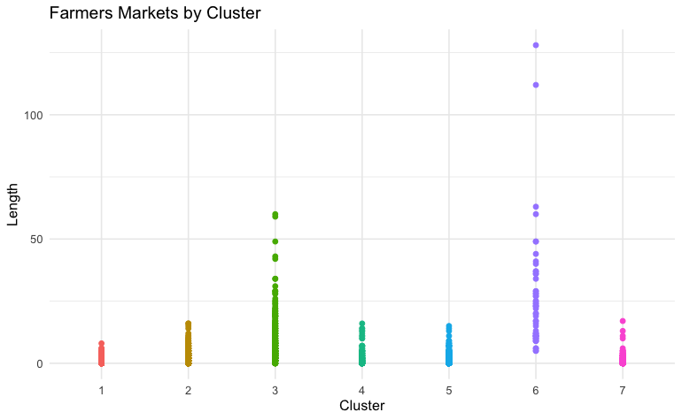

Slide 23
Model Selection
The response variable, number of farmers market per county, is a count variable, ranging from 0 to 128.
Poisson, negative binomial, and zero-inflated negative binomial models using a variety of combination of variables were tested and evaluated.

Slide 24
Model Selection
The final model was selected on the basis that:
1. it represented factors that prior researched deemed significant
2. it reduced the AIC of the model
3. it met model assumptions
4. all remaining variables were statistically significant
5. it had the fewest number of variables

Slide 25
Model Selection
The final model contained the following variables:
Total population
Green Party 2016
Median earnings
Median age
Renter occupied household
Poor physical health days
Temperature
Graduate degree

Slide 26
Model Selection
Farmers markets are positively correlated with:
Total population
Green Party 2016
Renter occupied household
Temperature
Graduate degree
and negatively correlated with:
Median age
Poor physical health days
WARNING: no causal evidence!!

Slide 27
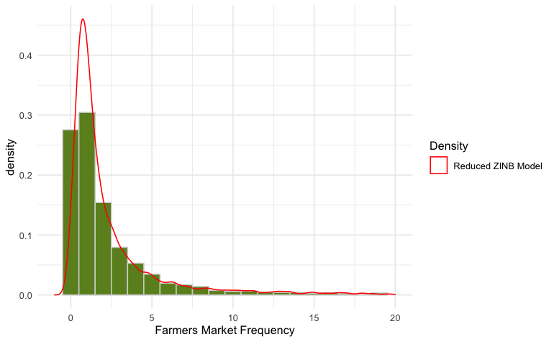
Model Selection

Slide 28
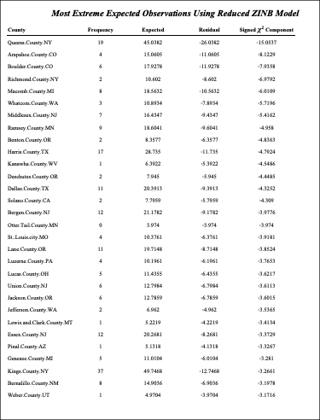
Findings
Here is the link to the
complete predictions

Slide 29
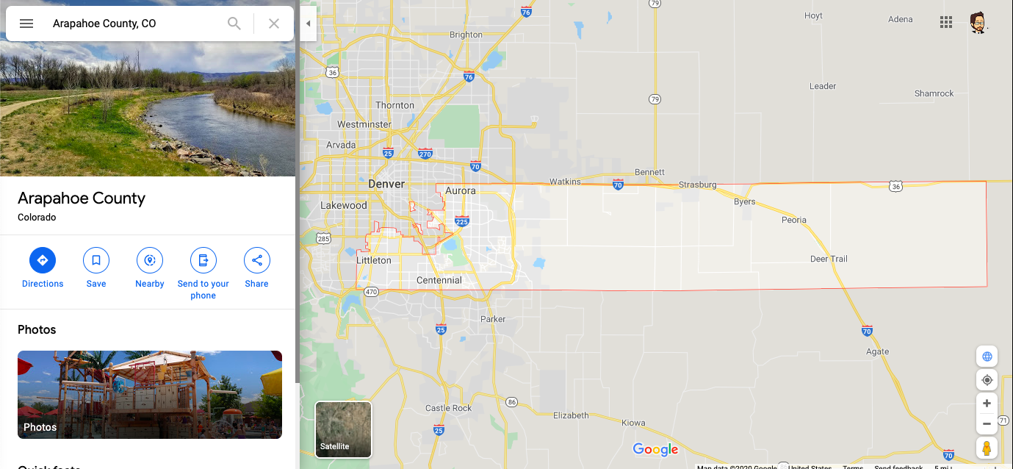
#2: Arapahoe County, CO: only 4 farmers markets. Population: 558k, politically liberal

Slide 30
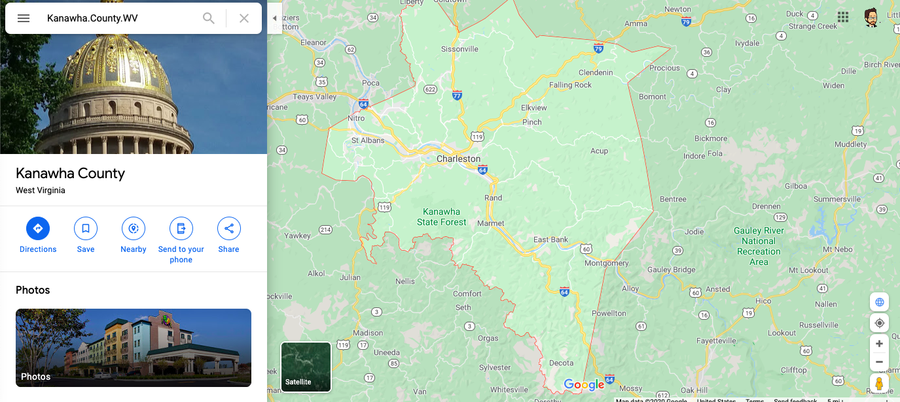
#11: Kanawha County, WV: only 1 farmers market. Population: 192k, Green Party

Slide 31
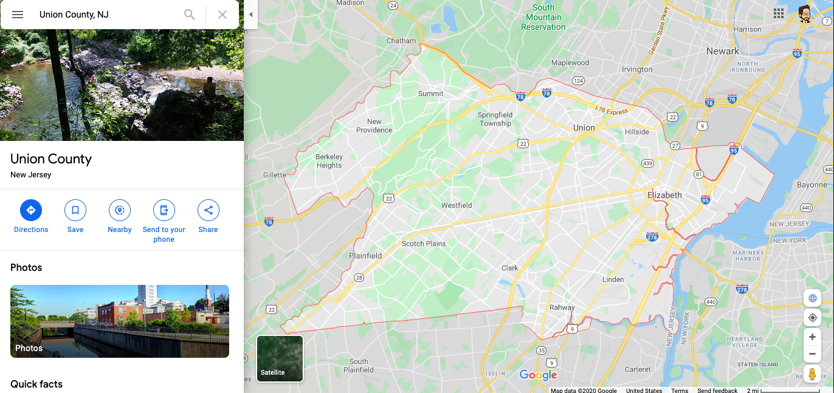
#23: Union County, NJ: 6 farmers market, expect 13. Population: 529k, high Graduate deg.
.

Slide 32
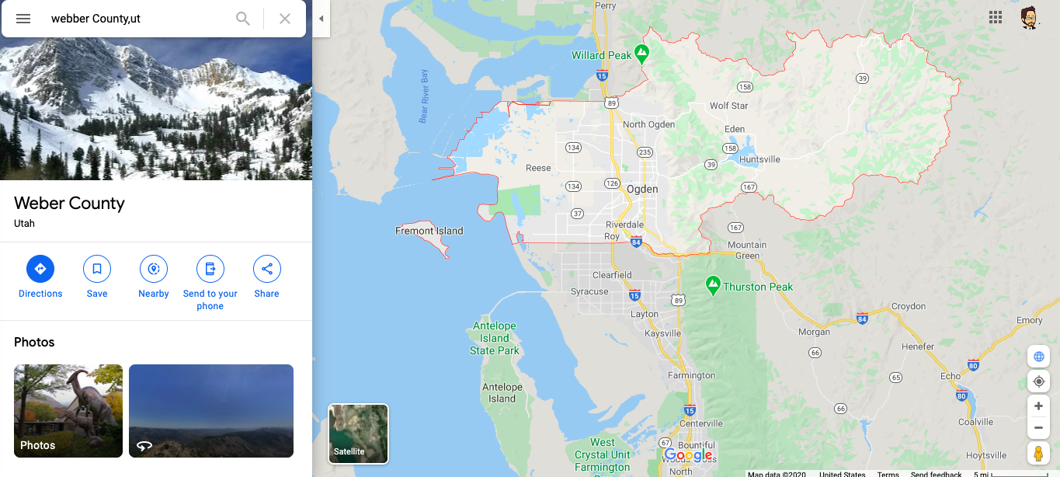
#30: Weber County, UT: 1 farmers market, expect 5. Population: 226k, “average” profile
.

Slide 33
Limitations
This is an observational study, so there is no evidence of causation.
Model is not definitive– investigate candidates!
model will miss neighboring counties
model does not consider the weekly occurrences of farmers markets
Model is based on present conditions
biases in the distribution of farmers market will be captured by the model
Example: poor health metric negatively correlated
this might be an opportunity

Slide 34
Proposed Actions
If someone were interested in opening a new farmers market without a location in mind:
Use the “FarmersMarketPredictions.csv” table for best candidates (ranked).
If someone were interested in opening a new farmers market with a location already in mind:
Look up the county in the “FarmersMarketPredictions.csv” table to compare observed (Freq) and expected (ExpectedFreq).

Slide 35
Expected Benefits
• Potential markets have been identified
• The model is flexible and can include and/or evaluate different factors if needed.
• The county level statistics and this methodology can be used to be evaluate the frequency of other variables beside farmers markets.
• Farmers markets are positive for the communities they support.

Slide 36
Sources
McCarthy, R. (2010). Evaluating the Social, Financial and Human Capital Impacts of Farmers Markets: Market Umbrella. 1:10

